Slide 1


Slide 2


IMAGE SEGMENTATION
NHD: TS. Nguyễn Huy Hoàng
Khoa Điện tử - Trường Điện – Điện tử

Slide 3

Content
History of Development
Classification of Solutions
Some Popular Solutions Today
Implementation Trends
Practical Applications

Slide 4
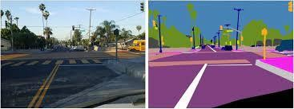
History of Development
Before 2000, some commonly used methods in digital image processing were:
threshold segmentation
region segmentation
edge segmentation
Clustering
Since 2010, the application of neural networks and deep learning has increased.

Slide 5
Threshold Based Segmentation
This method helps create a binary or multi-color image by setting threshold values ​​based on the pixel intensity of the original image.
Thresholding includes techniques such as:
Global thresholding;
Manual thresholding;
Local Adaptive Thresholding.

Slide 6
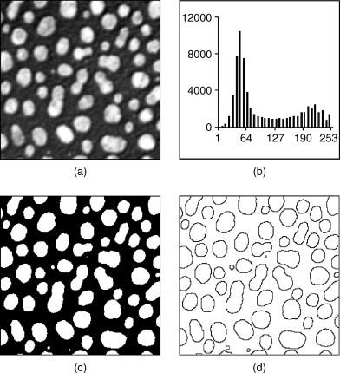
Threshold Based Segmentation
Phân ngưỡng bao gồm các kỹ thuật như:
Global manual thresholding
Local Adaptive Thresholding

Slide 7
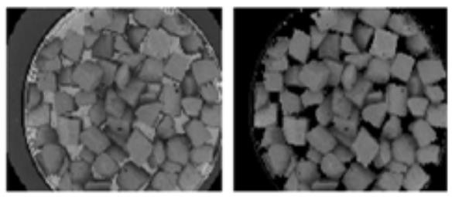
Threshold Based Segmentation
Manual thresholding

Slide 8
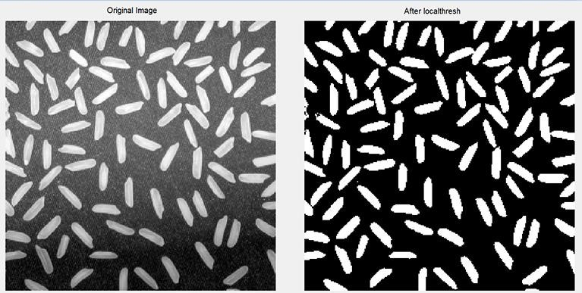
Threshold Based Segmentation
Local Adaptive Thresholding

Slide 9
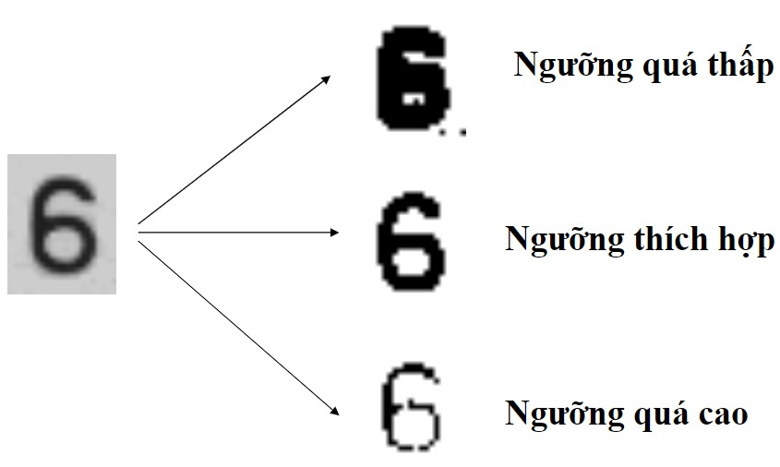
Threshold Based Segmentation
Disadvantages of threshold-based partitioning methods: difficulty in finding the optimal threshold.

Slide 10
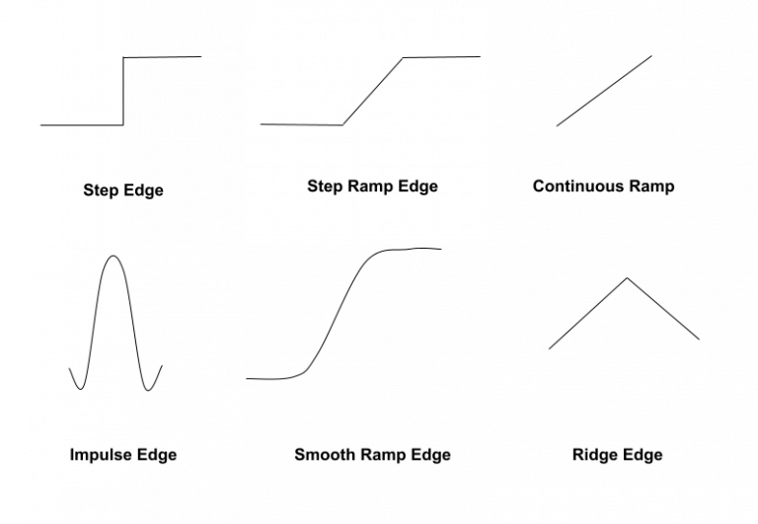
Edge Based Segmentation
Edges in an image mark discontinuous areas of grayscale, color, and texture.
When moving from one area to another, the grayscale level may change.
Edges are often associated with “Gradient" and "Direction".

Slide 11
Region-Based Segmentation
A region can be classified as a group of pixels that are connected and share similar attributes such as intensity, color, etc.
In this type of region classification, there are certain predefined rules that pixels must follow to ensure they can be classified into similar pixel regions.
There are two main groups of techniques:
Region growing method
Region splitting and merging method

Slide 12
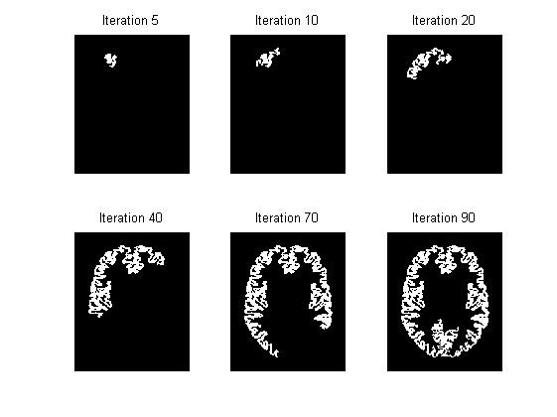
Region growing method
For this technique, we start with a number of pixels as seed pixels and then check adjacent pixels.
If adjacent pixels follow predefined rules, then that pixel is added to the region of the seed pixel, and the process continues until there are no more similarities.
This method takes a bottom-up approach. In the case of a growing region, a priority rule can be set as a threshold.

Slide 13
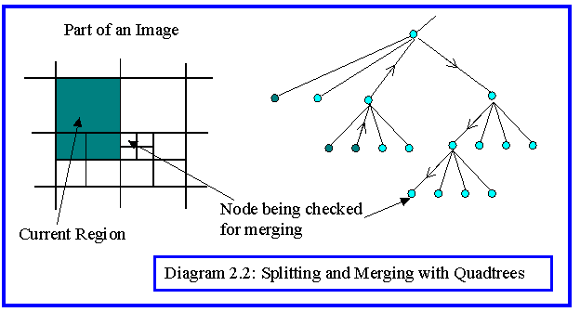
Region splitting and merging method
For region splitting, the entire initial image is captured as a single area.
If it doesn't follow the predefined rules, that area is then divided into multiple regions (usually four quadrants), and the rules continue to be applied to determine whether further splitting is necessary.
This process continues until there are no more regions to split, meaning all areas follow the predefined rules.

Slide 14
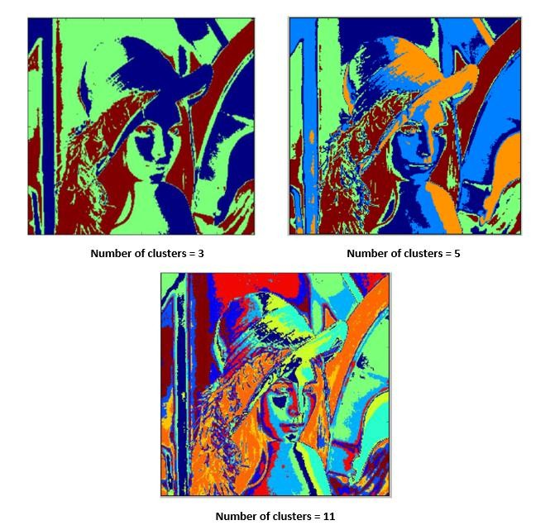
Clustering Based Segmentation
Clustering-Based SegmentationClustering is a type of unsupervised machine learning algorithm commonly used in image segmentation.
One of the clustering algorithms frequently applied to image segmentation is KMeans Clustering.

Slide 15
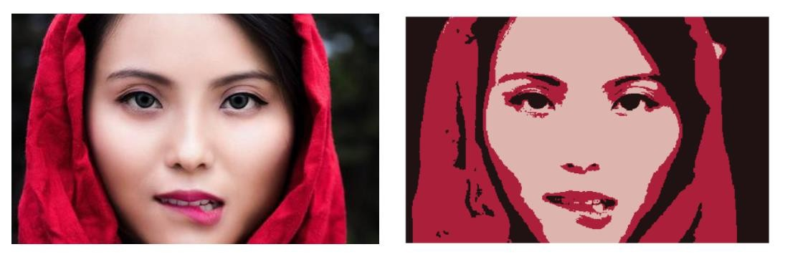
Clustering Based Segmentation
K-means : The k-means clustering algorithm groups the intensity of pixels in an image into clusters. Then, the value of each pixel is replaced by its centroid to segment the image.

Slide 16
Artificial Neural Network Based Segmentation
Artificial Neural Network Based SegmentationThis technique uses AI to automatically analyze an image and identify its different components such as faces, objects, and text.Experts at Facebook AI Research (FAIR) have created a deep learning architecture called Mask R-CNN, which can be used as a smart pixel filter for any object in an image.Other solutions include: Unet, FCN, Yolact, Solo, etc.

Slide 17
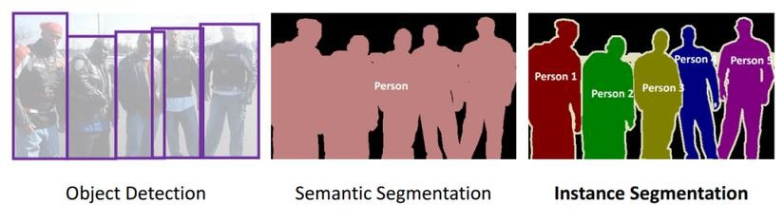
TYPES OF IMAGE SEGMENTATION
Semantic segment: Assign a label to each pixel using the class that the object belongs to
Instance Segment: This is a more advanced problem than semantic segmentation – it can detect and distinguish individual objects within a group of objects of the same class.

Slide 18
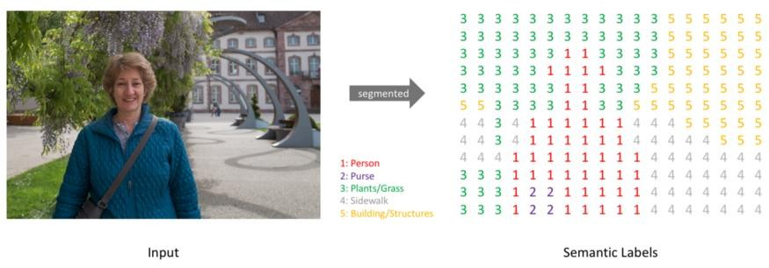
OUTPUT OF SEGMENTATION MODEL
Labels of Semantic Segmentation

Slide 19
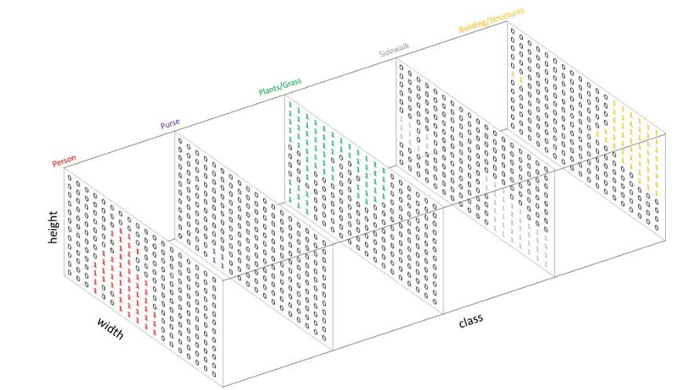
OUTPUT OF SEGMENTATION MODEL
Output of Semantic Segmentation model

Slide 20
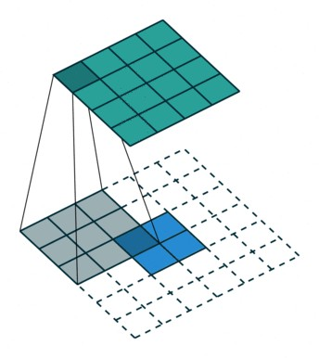
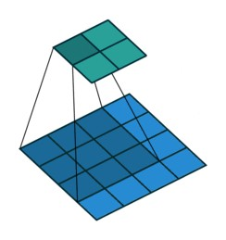
UNET – SEMANTIC SEGMENTATION SOLUTION
Convolution
Deconvolution (Transpose convolution)

Slide 21
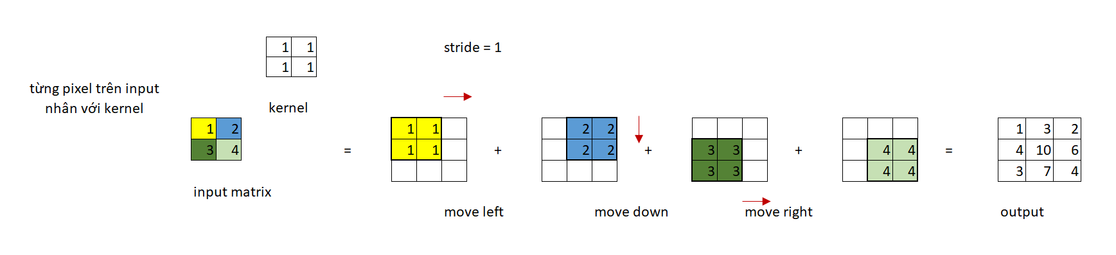
UNET – SEMANTIC SEGMENTATION SOLUTION
Deconvolution (Transpose convolution)

Slide 22
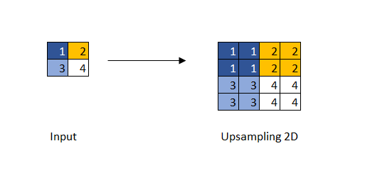
UNET – SEMANTIC SEGMENTATION SOLUTION
Upsampling 2D

Slide 23
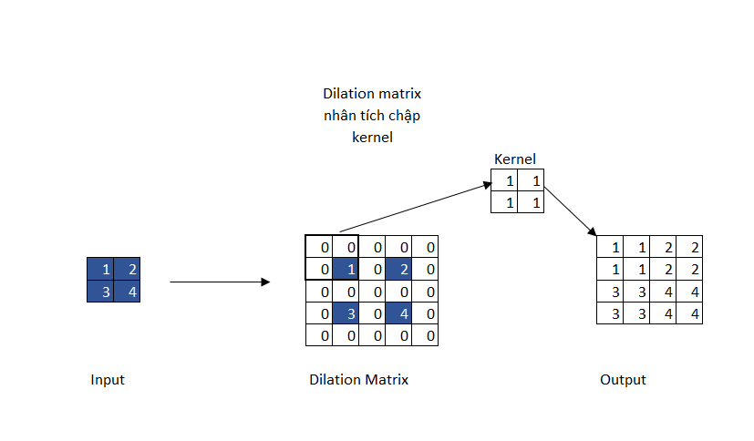
UNET – SEMANTIC SEGMENTATION SOLUTION
Tích chập giãn nở

Slide 24
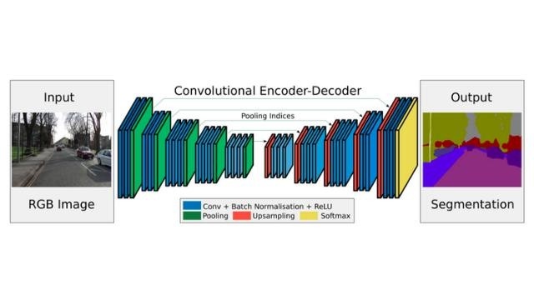
UNET – SEMANTIC SEGMENTATION SOLUTION
The network architecture includes an encoder and a decoder.Encoder: extracts features from the image through filters. Decoder: produces the final output, usually a mask that partitions the objects.

Slide 25
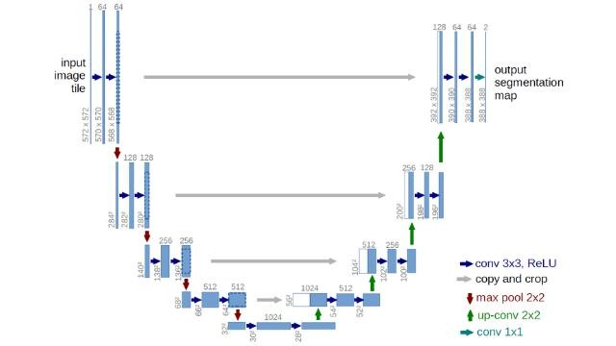
UNET – SEMANTIC SEGMENTATION SOLUTION

Slide 26
DeepLab V1+V2
DeepLab V1 and V2 were first published in 2016 and again in 2017 by authors Liang-Chieh Chen and George Papandreou, long-time researchers in Semantic Segmentation.
This architecture flexibly applies Atrous convolution instead of the previous methods using Transposed Convolution. In addition, the authors also applied Conditional Random Field to refine the prediction results for greater accuracy.

Slide 27
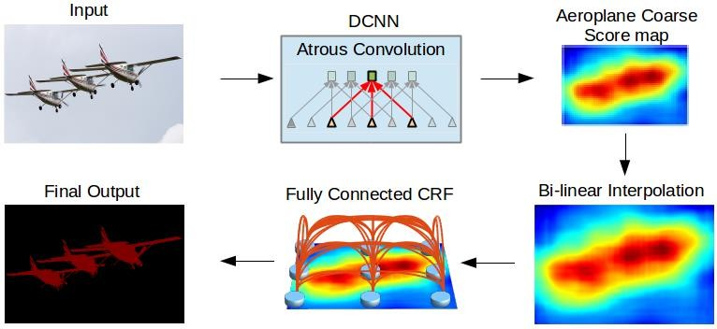
DeepLap V1+V2
Input -> DCNN -> Score Map -> bilinear interpolation -> Fully Connected CRF -> mask output

Slide 28
DeepLab V1+V2
DeepLab employs a DCNN with Atrous Convolutions to extract image features, providing a larger receptive field while preserving spatial information and maintaining a similar number of parameters and computational cost compared to standard convolutions.
The DCNN generates a coarse score map, which represents the extracted features of the input image but has a lower resolution than the original image.
Bilinear Interpolation is used to upsample the score map back to the original image size while preserving the overall spatial layout.
A Fully Connected Layer combined with a Conditional Random Field (CRF) is applied to refine and normalize pixel-level labels.
The final output is a segmentation map with sharper boundaries and more accurate object regions, resulting in improved pixel-wise classification performance.

Slide 29
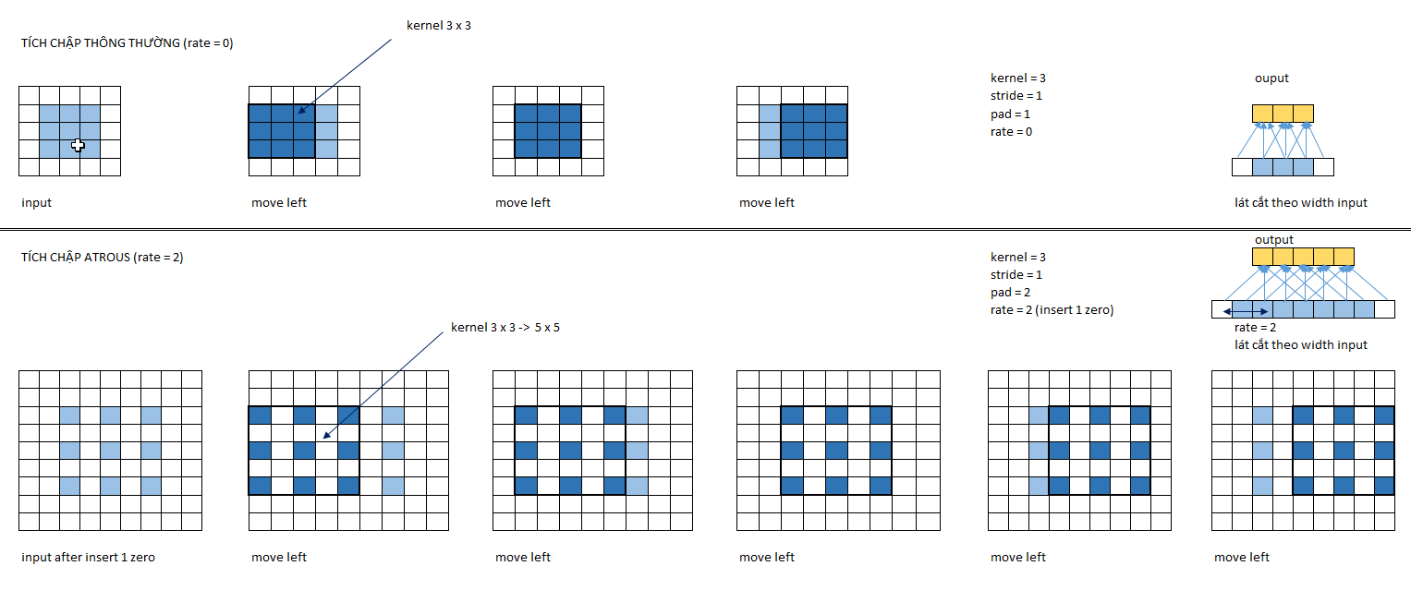
DeepLab V1 + V2 - Atrous Convolution

Slide 30
DeepLab V1 + V2 - Atrous Convolution
Austros convolution has the following effects:
Increases the output size compared to the input.
A larger perceptual area expands the filter's field of view and is suitable for broader contexts.
This is a mechanism that allows control over the field of view and finding the most reasonable trade-off between local accuracy (applied to narrow field of view) and contextual uniformity (applied to wide field of view).
For austros convolution, we are interested in the following indices:
Rate: denoted by R, is the distance between consecutive rows or columns after inserting zero rows and columns.
If rate = r, then every other row or column there are r-1 zero rows or columns.
Kernel: denoted by K, the filter size.
Padding: denoted by P, the size of the zero padding surrounding the image.
Stride: denoted by S, the number of steps moved per convolution.

Slide 31
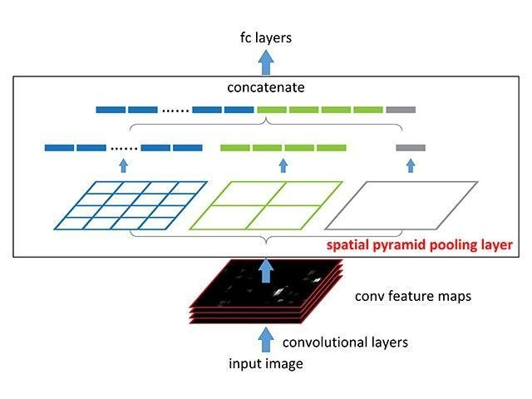
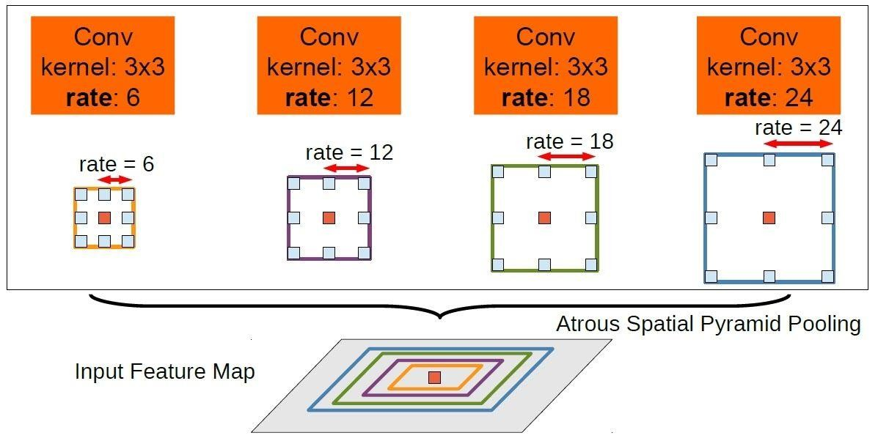
DeepLab V1 + V2 - Atrous Spatial Pyramid Pooling (ASPP)

Slide 32
DeepLab V1 + V2 – Conditional Random Field (CRF)
Deeplab V2 uses ASPP to obtain a feature map that synthesizes the context across multiple spatial regions of varying sizes.
To return to the input size, the feature map is then scaled up using bilinear interpolation.
Boundaries are refined for sharper detail, and object shapes are smoothed through Fully Connected Conditional Random Fields.

Slide 33
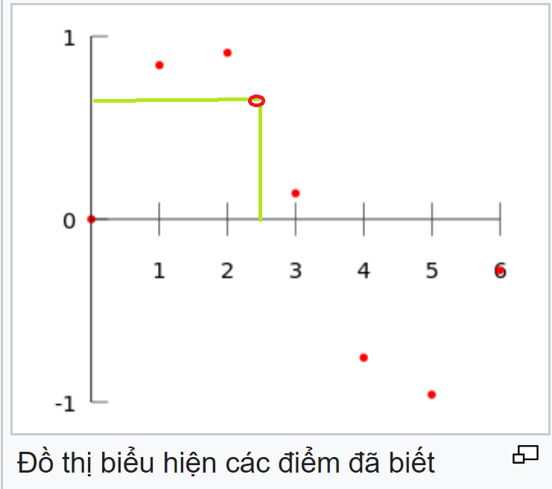
DeepLap V1+V2 – CRF – Bi-linear interpolation
Bilinear interpolation:
Interpolation: A method for estimating the value of unknown data points within a discrete set containing several known data points.
Linear interpolation: Linear interpolation is a process that allows you to infer a value between two clearly defined values. This can be in a table or in a linear graph.

Slide 34
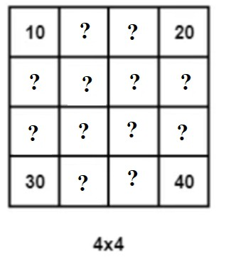
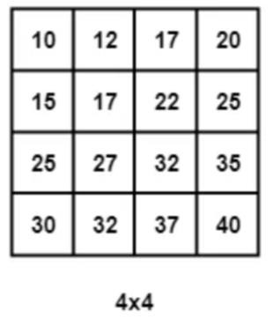
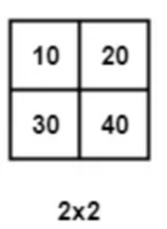
DeepLap V1+V2 – CRF – Bi-linear interpolation
Bilinear interpolation in image processing: performing two linear interpolations tofind the values ​​of pixels.

Slide 35
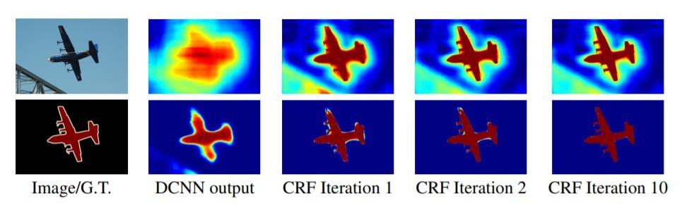
DeepLab V1 + V2 – Conditional Random Field (CRF)
The fully connected CRF layer, also known as DenseCRF post-processing, is a final processing step to calculate the probability distribution for the output. The fully connected CRF layer applies Conditional Random Field (CRF) techniques to make the predictions for the pixels more accurate.

Slide 36
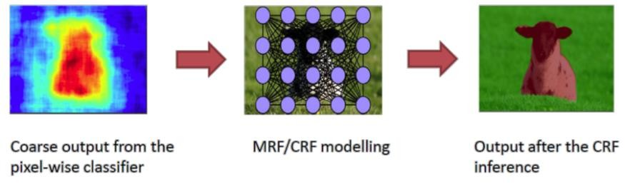
DeepLap V1+V2 – CRF – Conditional Random Field
Conditional Random Field : A conditional random field (CRF) is a conditional probabilistic classification model. A normal classification model predicts a label for a sample without considering its context (neighboring samples), while a CRF can incorporate context into the labeling process.

Slide 37
DeepLab V3
In DeepLabV3, the author introduced two improvements:
Performing ASPP parallel convolution at various scales and adding batch normalization, inheriting the idea from Inception networks.
Removing Fully Connected CRF in the final processing step helps increase the computation speed.One of the challenges of segmentation using multi-layer deep learning DCNNs is that the feature map becomes smaller after each convolution layer.
Reducing resolution can lead to a loss of information about the location and detail of predicted objects.
In DeepLabV3, the author has tried to adjust the level of resolution reduction in the blocks of the DCNN network to maintain it at 16.

Slide 38
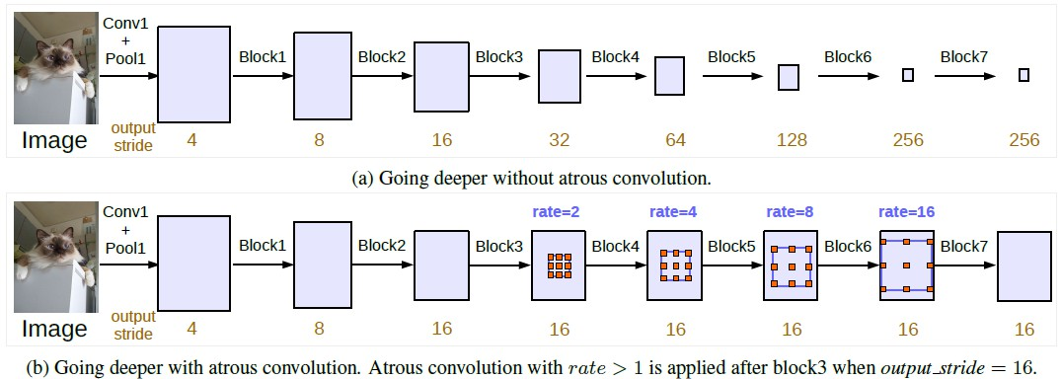
DeepLab V3

Slide 39
DeepLab V3
In the architecture of DeepLabV3, the author applies Atrous Convolution with various dimensions and creates improvements in output stride:
Without Atrous Convolution: In the first line, we only apply normal convolution and max-pooling. We see that the output stride increases significantly, causing the feature map to shrink with depth of the model. This is detrimental to segmentation because information is lost as resolution decreases at deeper layers.
With Atrous Convolution: In the second line, we can keep the resolution of the blocks stable while increasing the field-of-view without increasing the number of parameters and computations. Ultimately, we obtain a larger feature map while preserving location and spatial information. This is beneficial for segmentation.

Slide 40
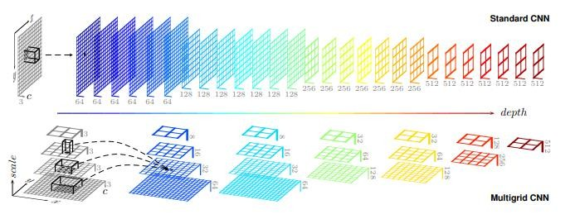
DeepLab V3 - MultiGrid

Slide 41
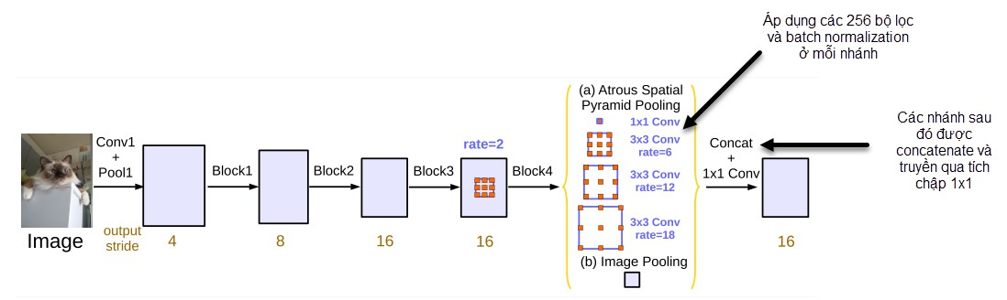
DeepLab V3 – Atrous Spatial Pyramid Pooling (ASPP)
The author also improved ASPP by adding batch normalization to the last feature before applying Atrous Convolution. The result was then passed through a 1 x 1 convolution with 256 filters. Finally, the author increased the resolution through Bilinear Upsampling to obtain the desired size.

Slide 42
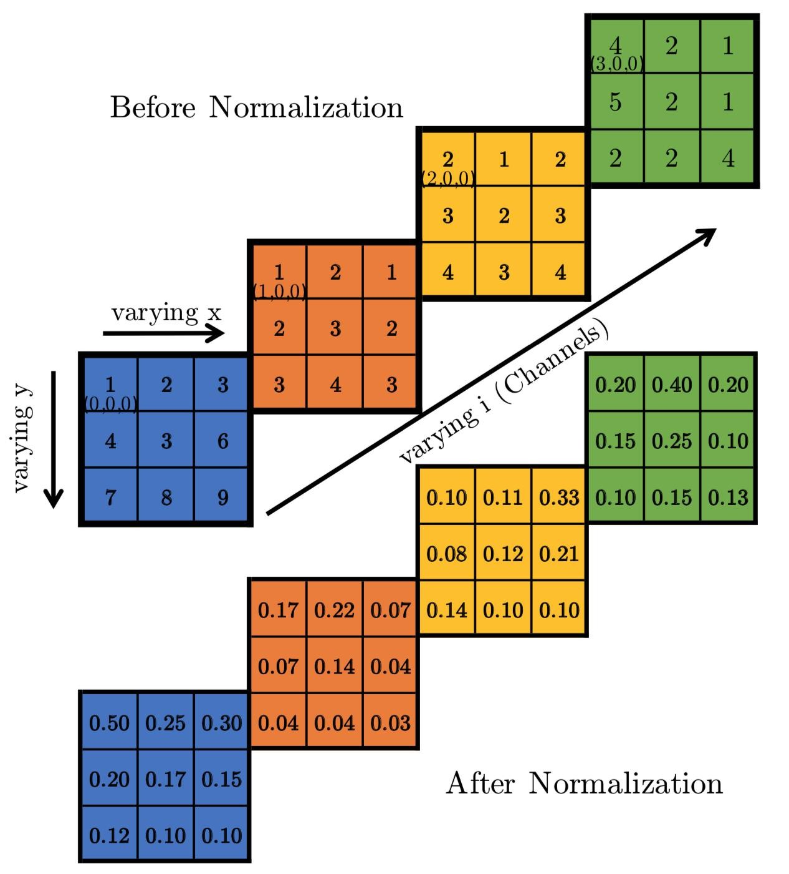
Batch normalization

Slide 43
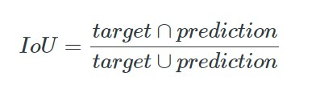
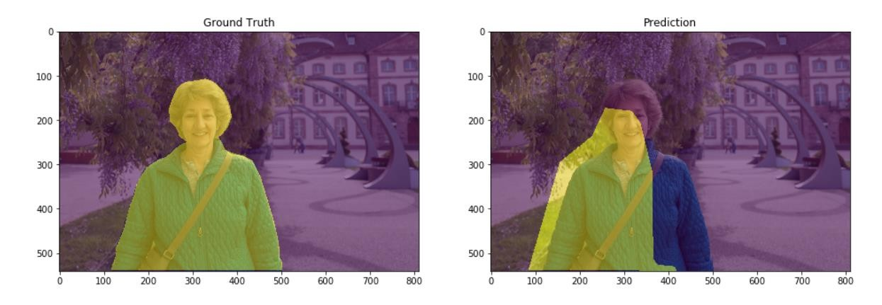
Performance metrics for semantic segmentation

Slide 44
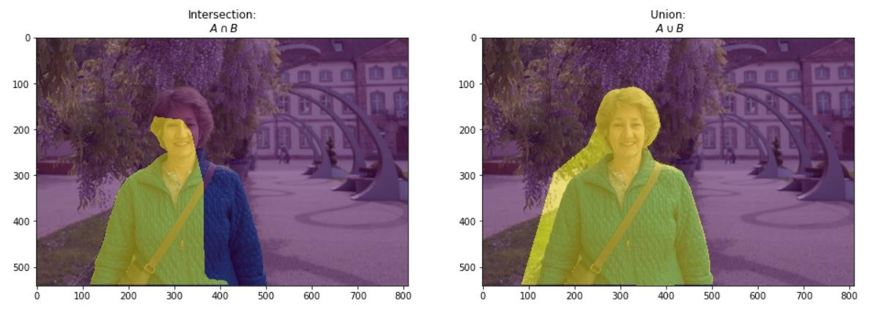
Performance metrics for semantic segmentation

Slide 45

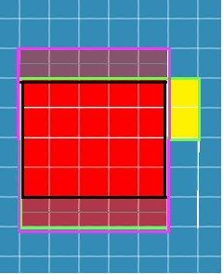
Performance metrics for semantic segmentation
TP: pixel phát hiện chính xác của vật thể
TN: pixel phát hiện được chính xác của đối tượng không phải vật thể
FP: pixel phát hiện nhầm là vật thể
FN: pixel của vật thể không phát hiện được

Slide 46
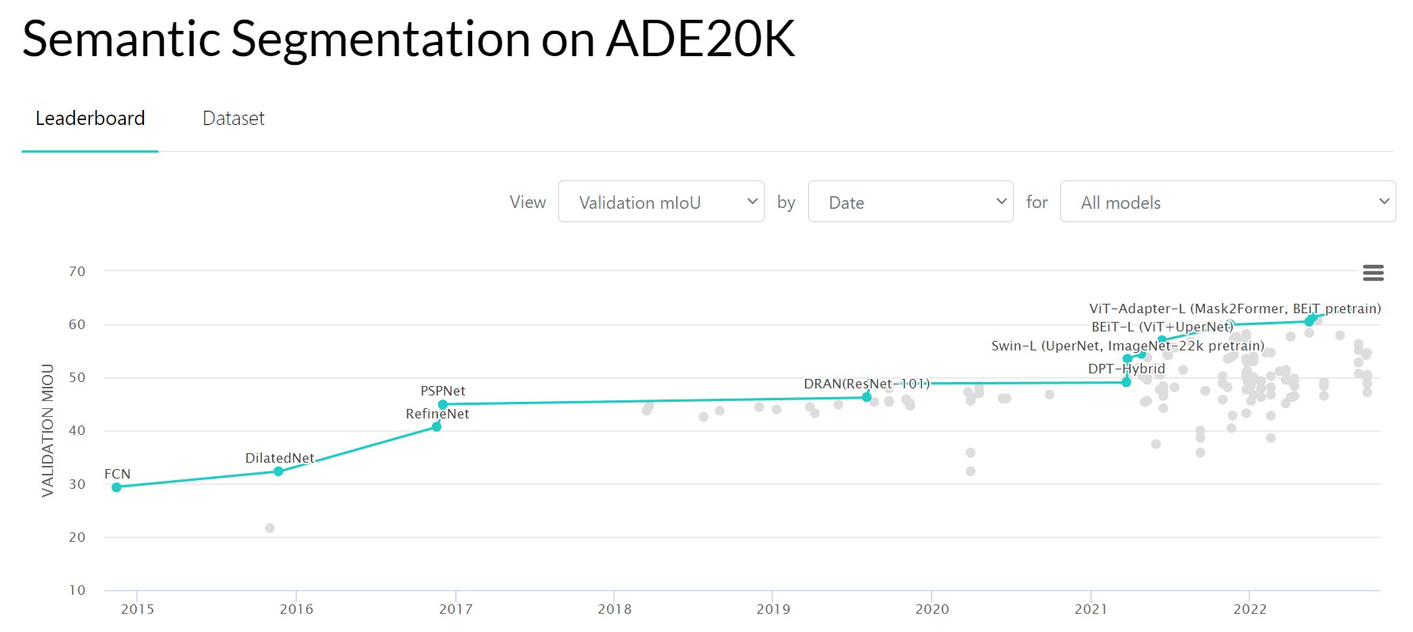
SEMANTIC SEGMENTATION SOLUTION
Cập nhật các giải pháp instance segmentation trên paper with code:

Slide 47
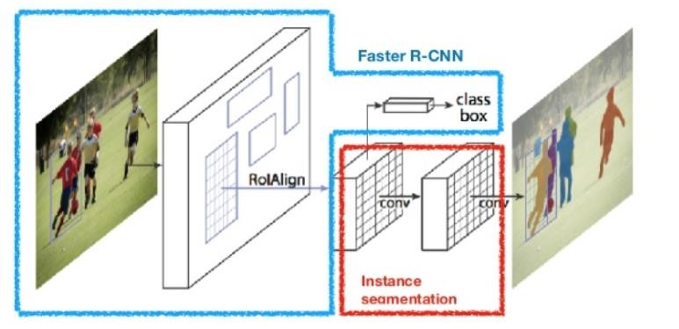
MASK RCNN – INSTANCE SEGMENTATION SOLUTION
MASK RCNN

Slide 48
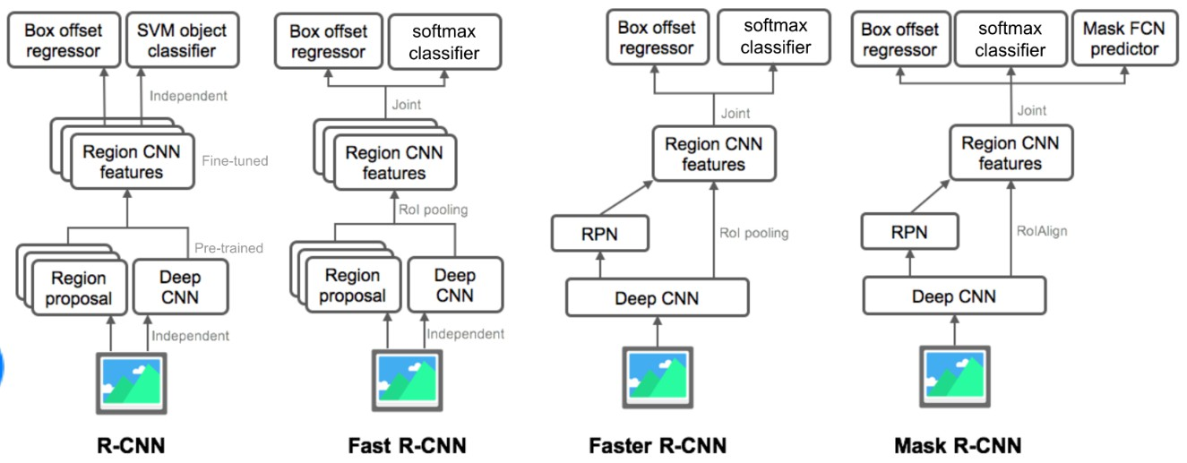
MASK RCNN – INSTANCE SEGMENTATION SOLUTION

Slide 49
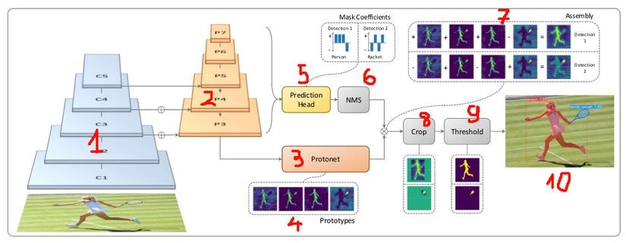
YOLACT – INSTANCE SEGMENTATION SOLUTION

Slide 50
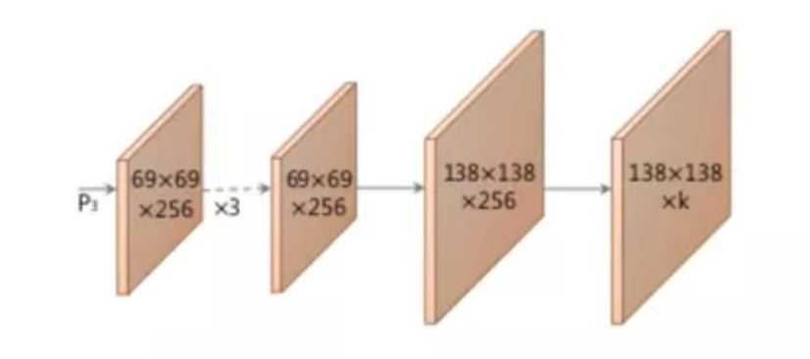
YOLACT – INSTANCE SEGMENTATION SOLUTION – PrototypeNet

Slide 51
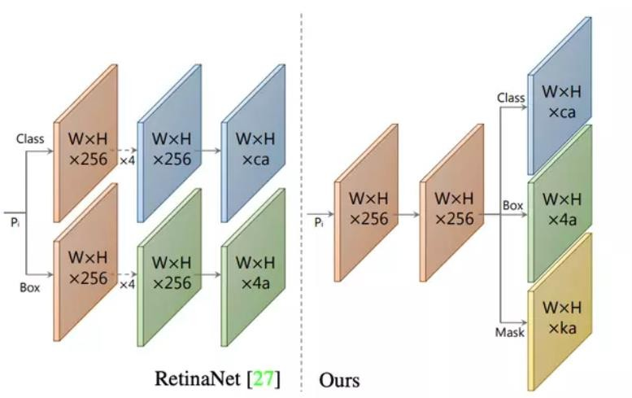
YOLACT – INSTANCE SEGMENTATION SOLUTION – Prediction Head

Slide 52
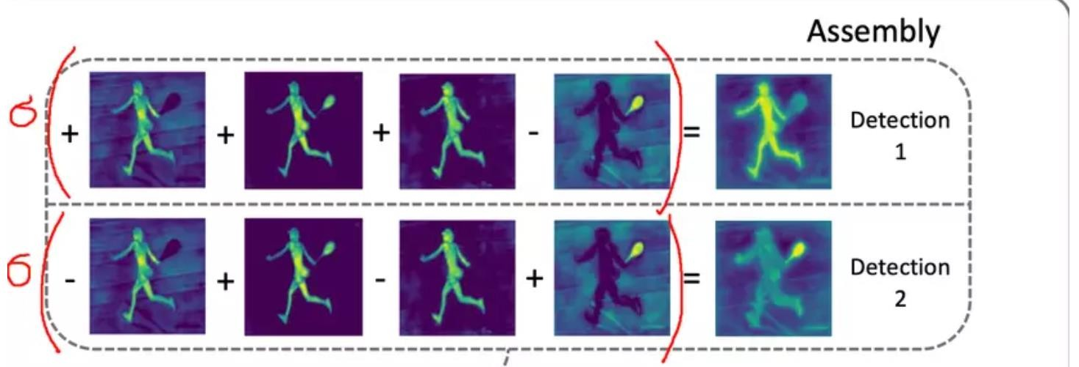
YOLACT – INSTANCE SEGMENTATION SOLUTION – Prediction Head

Slide 53
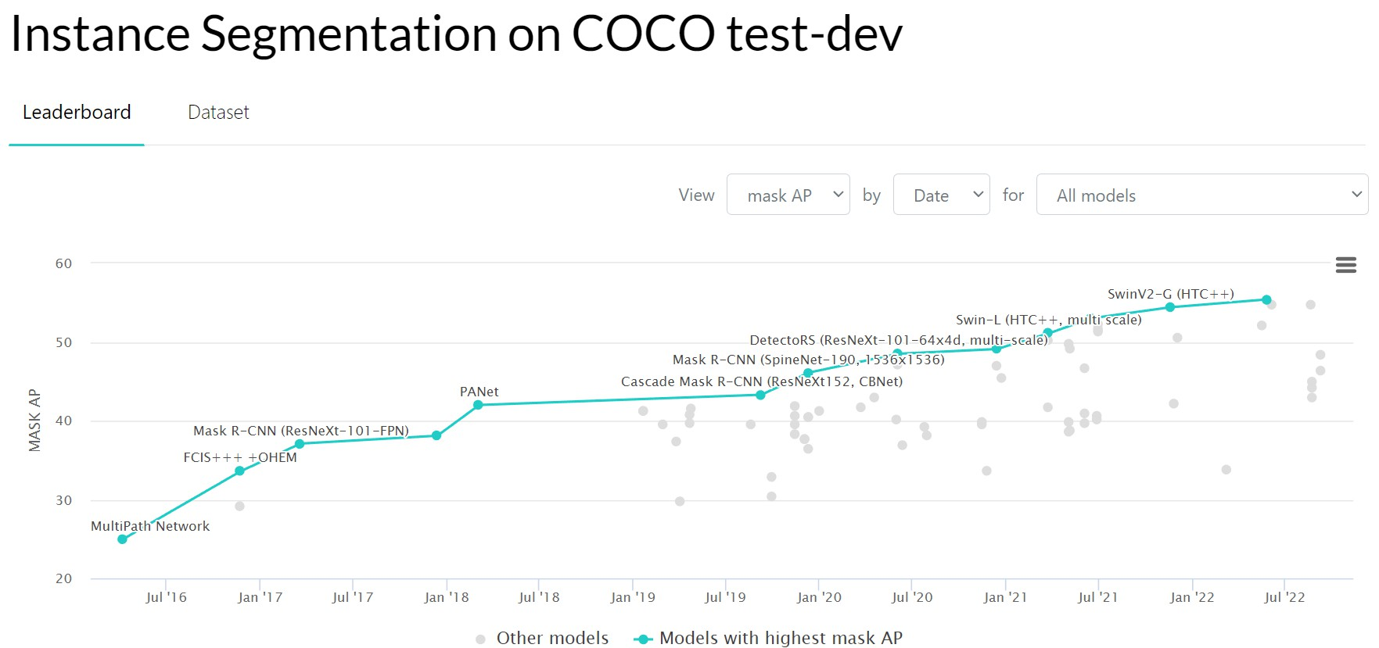
INSTANCE SEGMENTATION SOLUTION
Cập nhật các giải pháp instance segmentation trên paper with code:

Slide 54
Kết luận
Semantic Segmentation: Unet , FCN, DeepLab
Có thể coi DeepLab V3 là SOTA cho lĩnh vực Semantic Segmantion
hiện tại với Mean IoU trên PASCAL VOC 2012 test là 89%
Instance Segmentation = Object Detection + Semantic Segmentation
Phương pháp được biết đến rộng rãi nhất của Instance Segmentation là Mask R-CNN (mAP COCO = 46.1)
Code for image segmentation : https://github.com/open- mmlab/mmdetection

Slide 55
Application of image segmentation
Content-based image retrieval
Machine vision
Medical imaging (wide range of applications)
Object detection
Recognition tasks
Autonomous driving systems for autonomous vehicles
Security surveillance
Agriculture
Satellite image processing

Slide 56
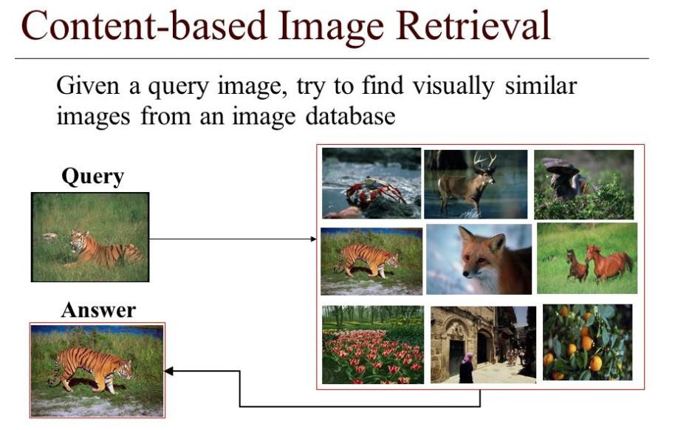
Application of image segmentation

Slide 57
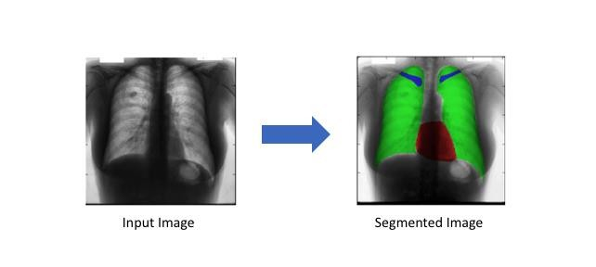
Application of image segmentation
Xử lý ảnh y tế (Medical imaging) (ứng dụng nhiều)

Slide 58
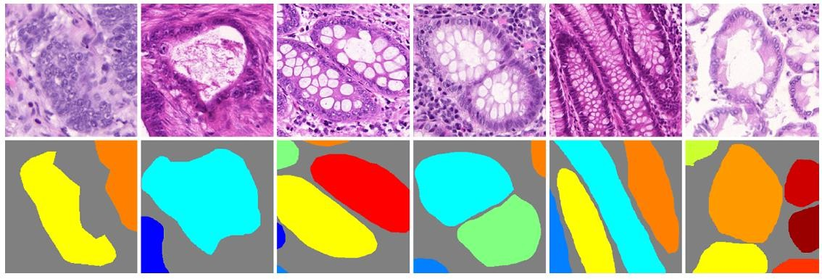
Application of image segmentation
Xử lý ảnh y tế: phân vùng tế bào ung thư

Slide 59
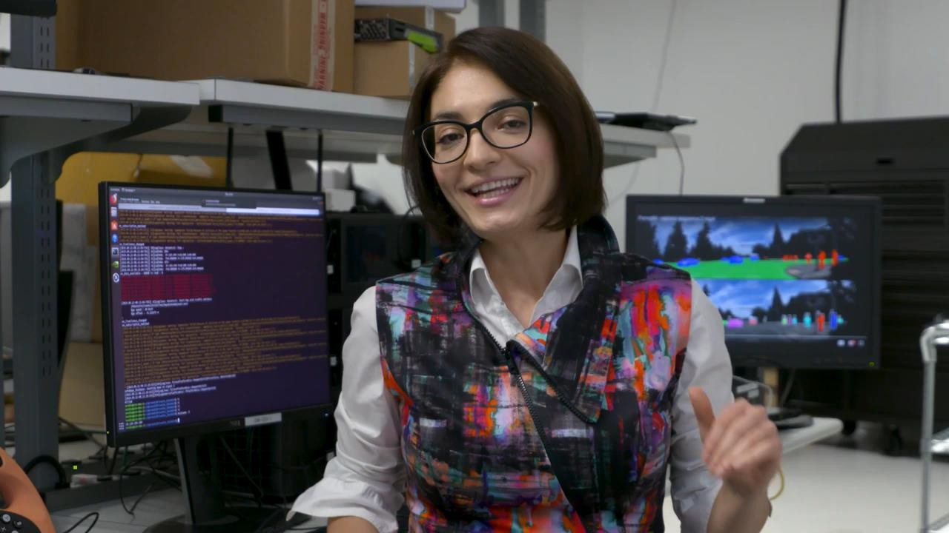
Application of image segmentation
Xe tự hành

Slide 60

Application of image segmentation
Giám sát an ninh

Slide 61

Application of image segmentation
Nông nghiệp

Slide 62

Application of image segmentation
Xử lý ảnh vệ tinh

Slide 63

THANK YOU !

